Slide 1

Project Connect Business Model
Papillion Incorporated©

Slide 2

Project Connect
Connect hobbyists, students, professionals and everyone who want to work together on a project
Global platform to enhance international relationships
Android based application (Stay tuned for more platforms)
Offered team finding, communication and management

Slide 3
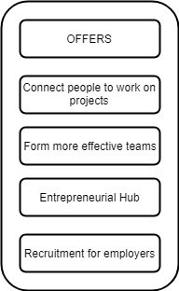
Value Proposition

Slide 4
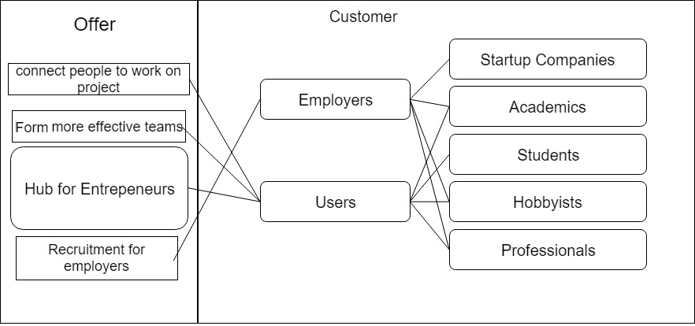
Customers

Slide 5
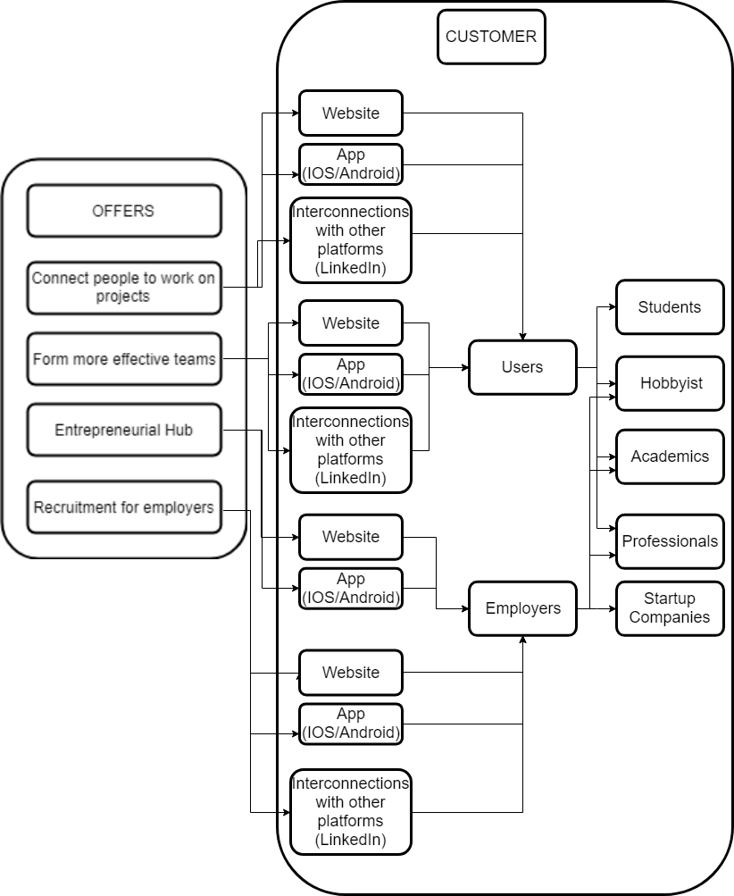
Customer Relations

Slide 6
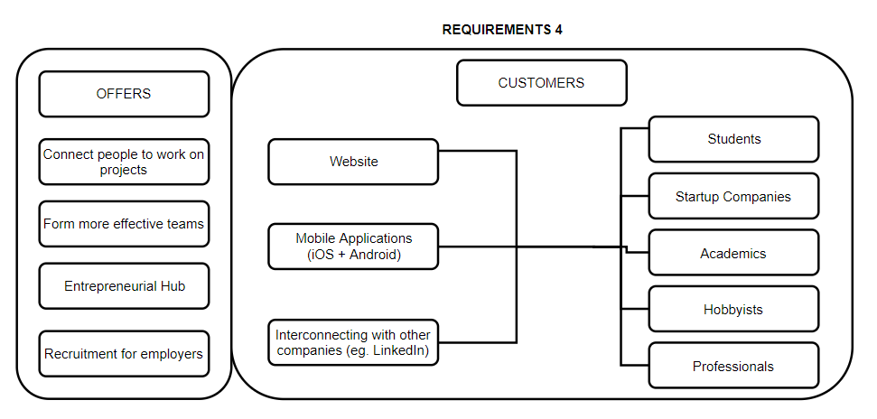
Distribution Channels

Slide 7
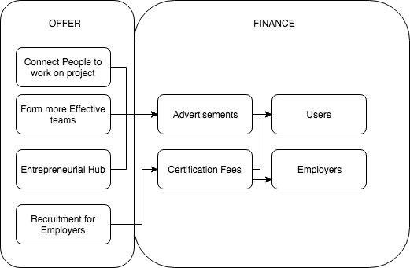
Revenue

Slide 8
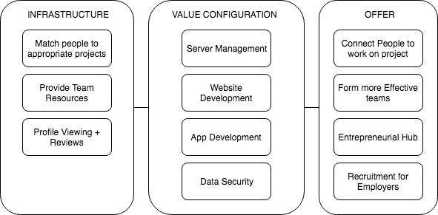
Configuration

Slide 9
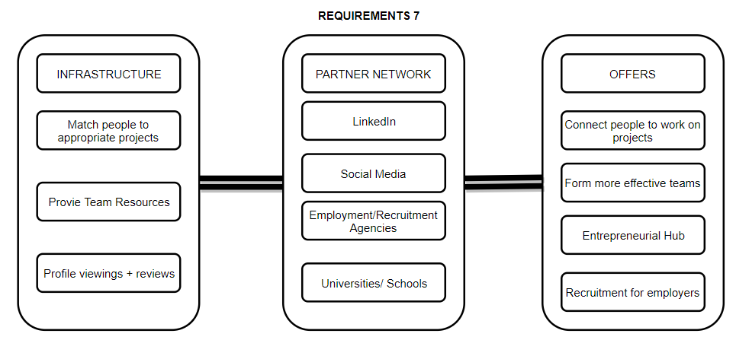
Partners

Slide 10
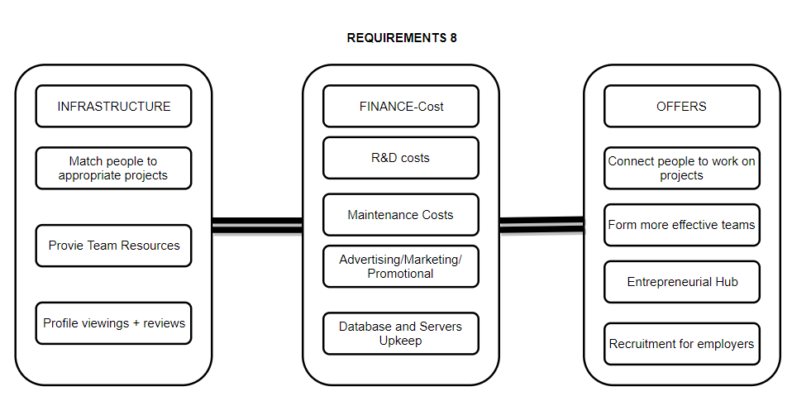
Costs

